Slide 1
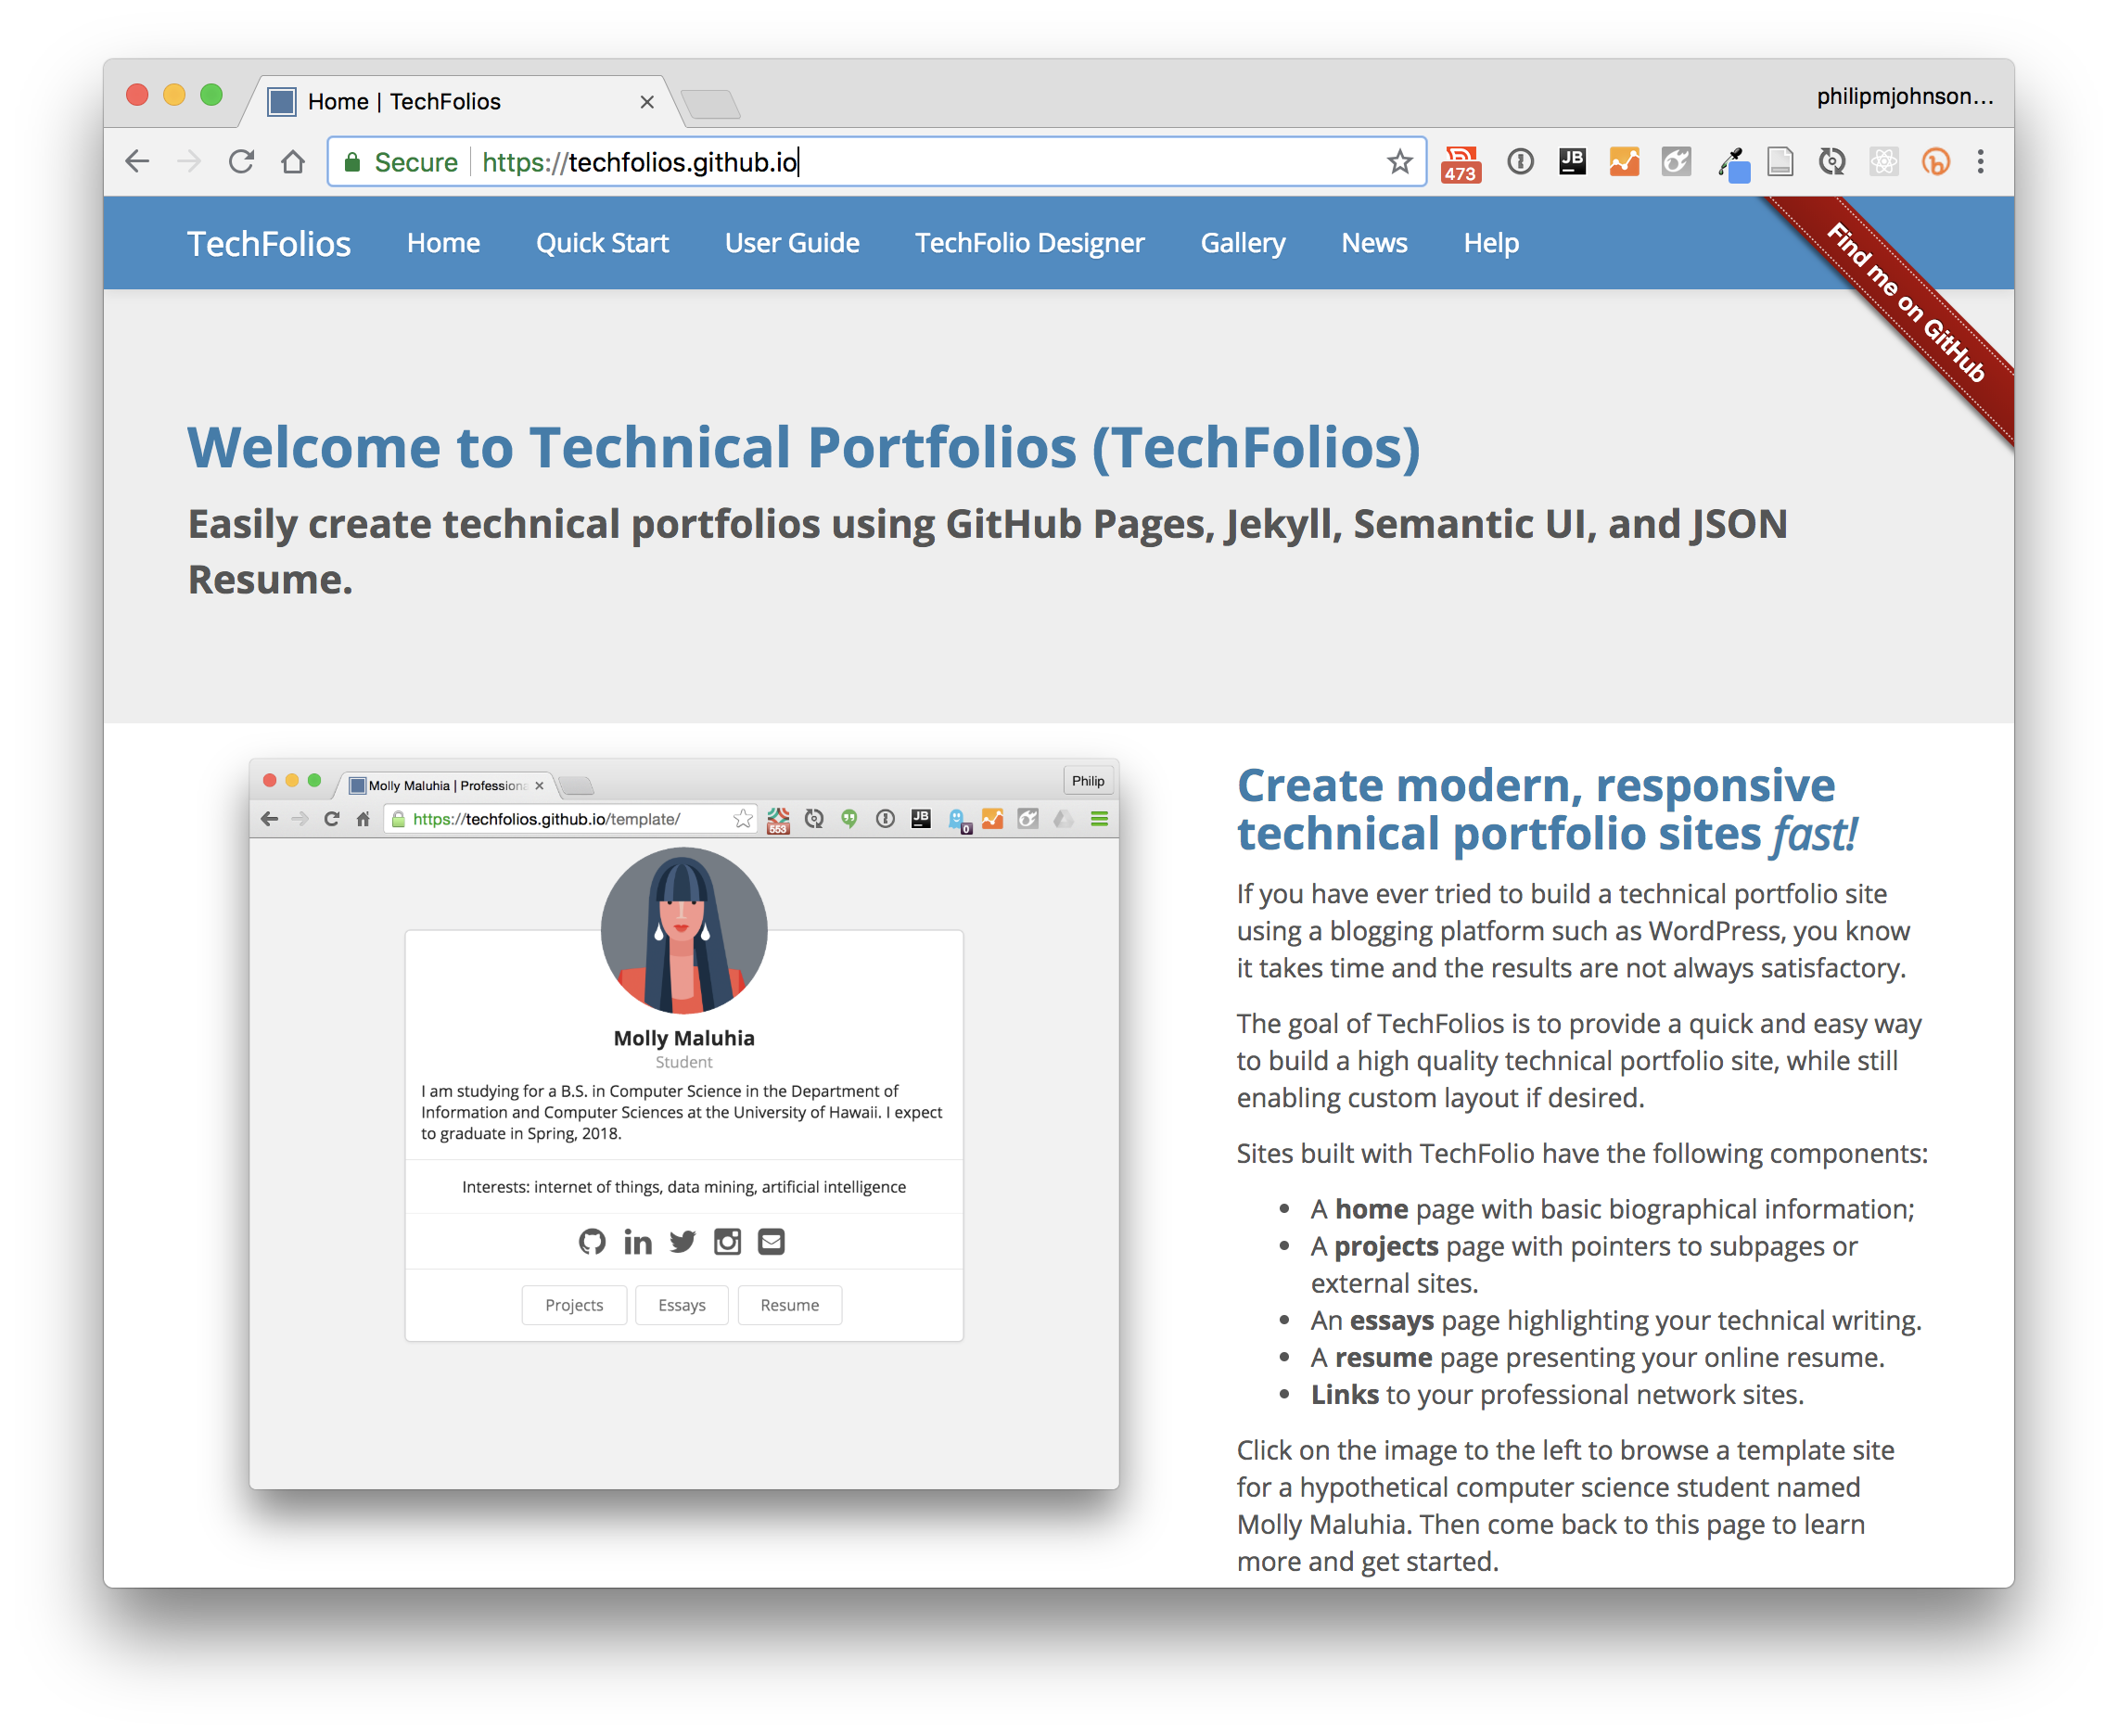

Slide 2
Why do we need yet another portfolio system?

Slide 3
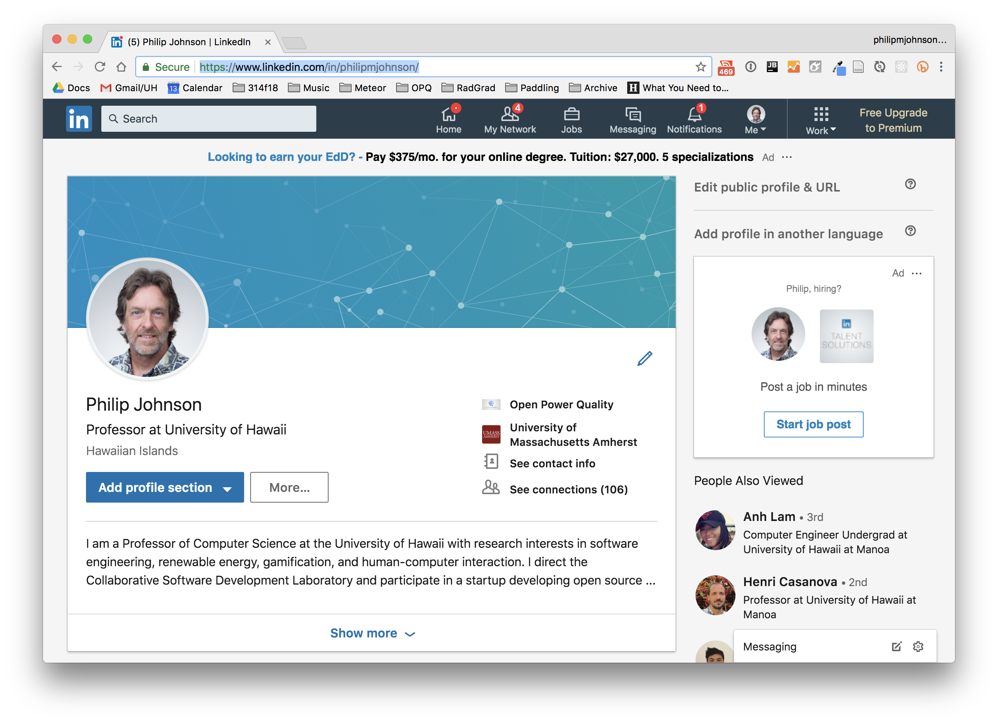

Slide 4
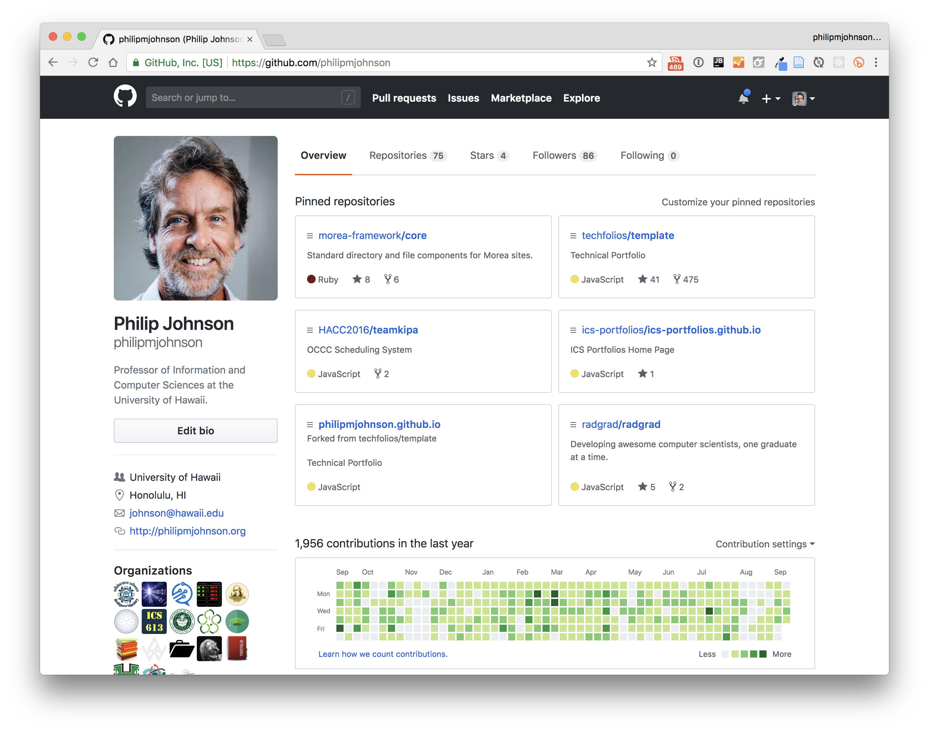

Slide 5
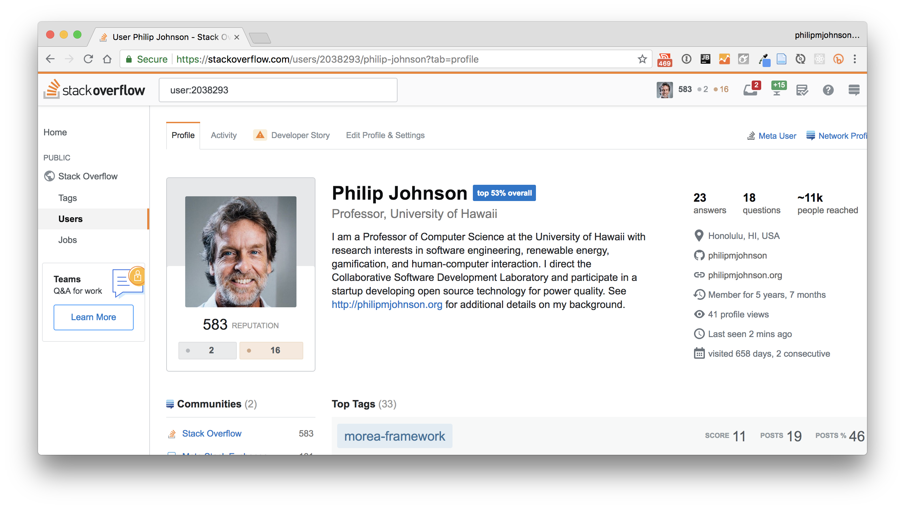

Slide 6
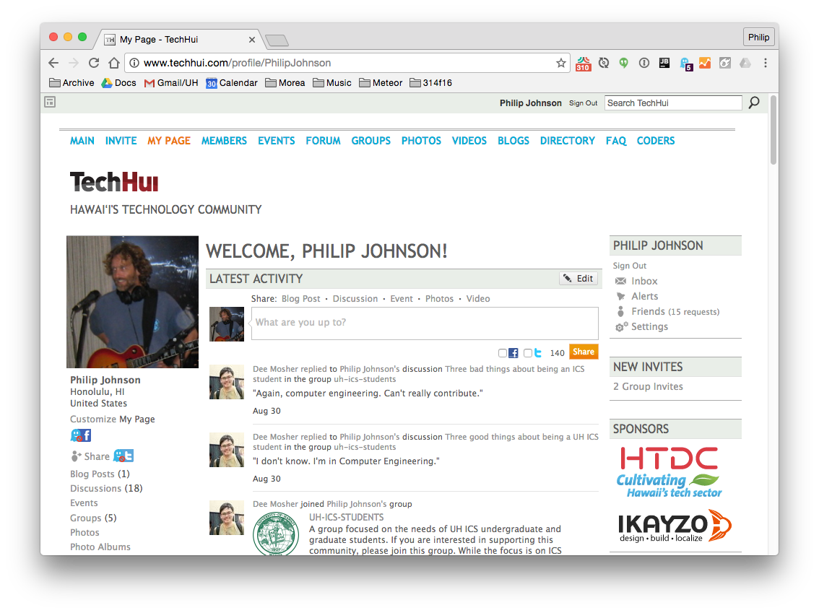

Slide 7
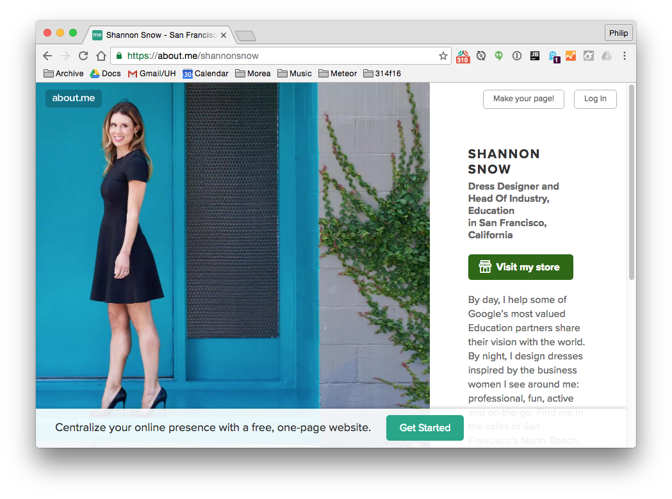

Slide 8
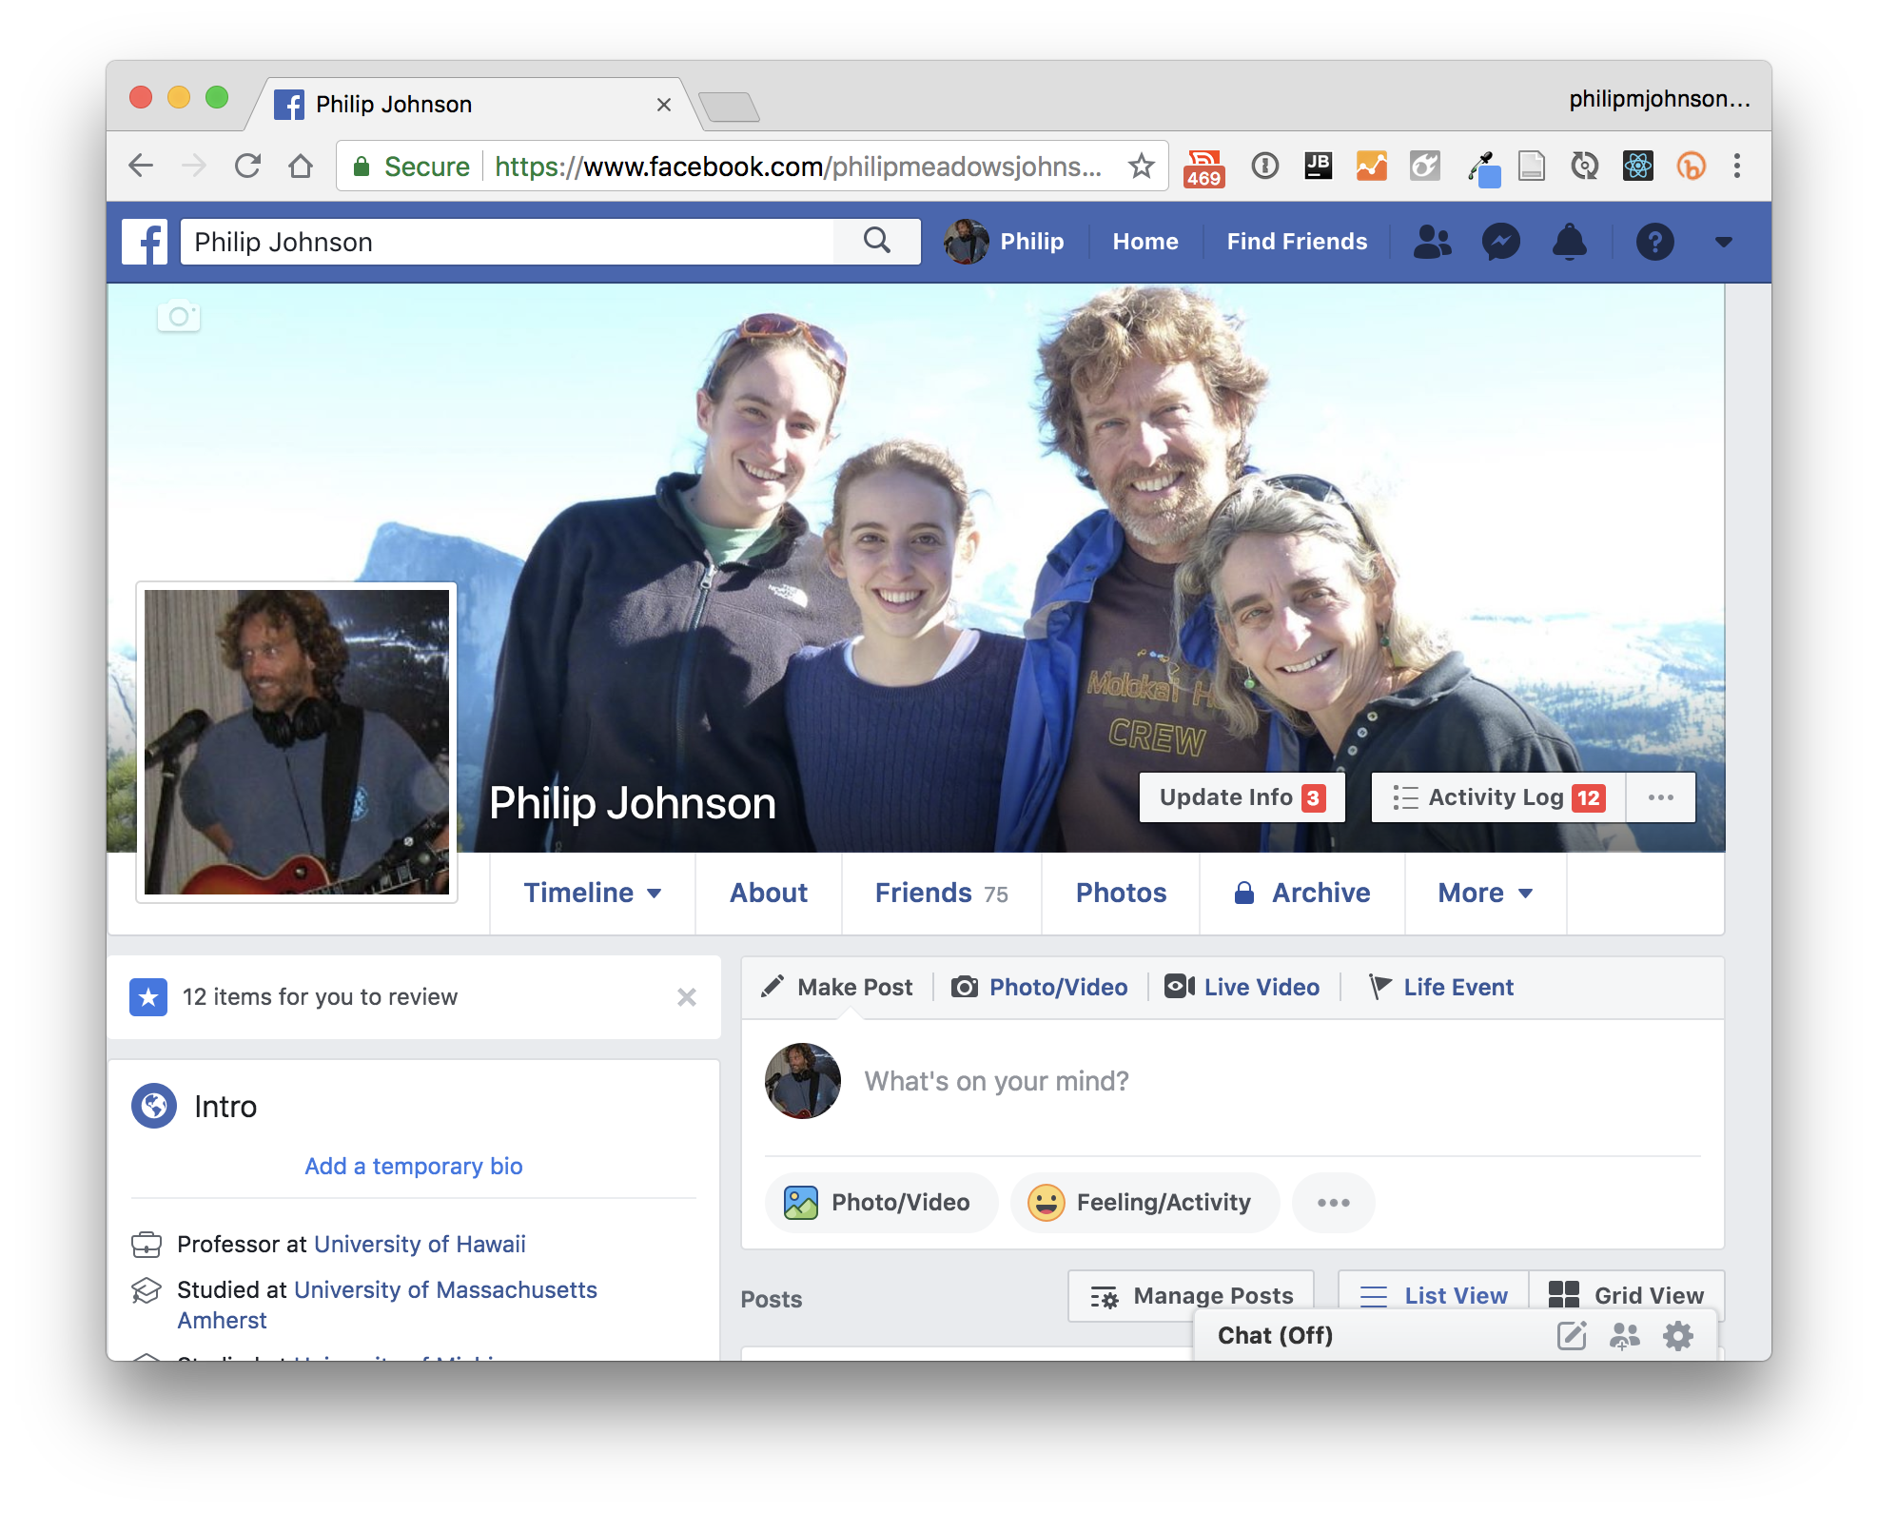

Slide 9
Problem 1:
These profiles are biased to the needs of their corporate overlords.

Slide 10
Problem 2:
These profiles make students (and “young professionals”) look bad.

Slide 11
Solution (First try)

Slide 12
WordPress

Slide 13
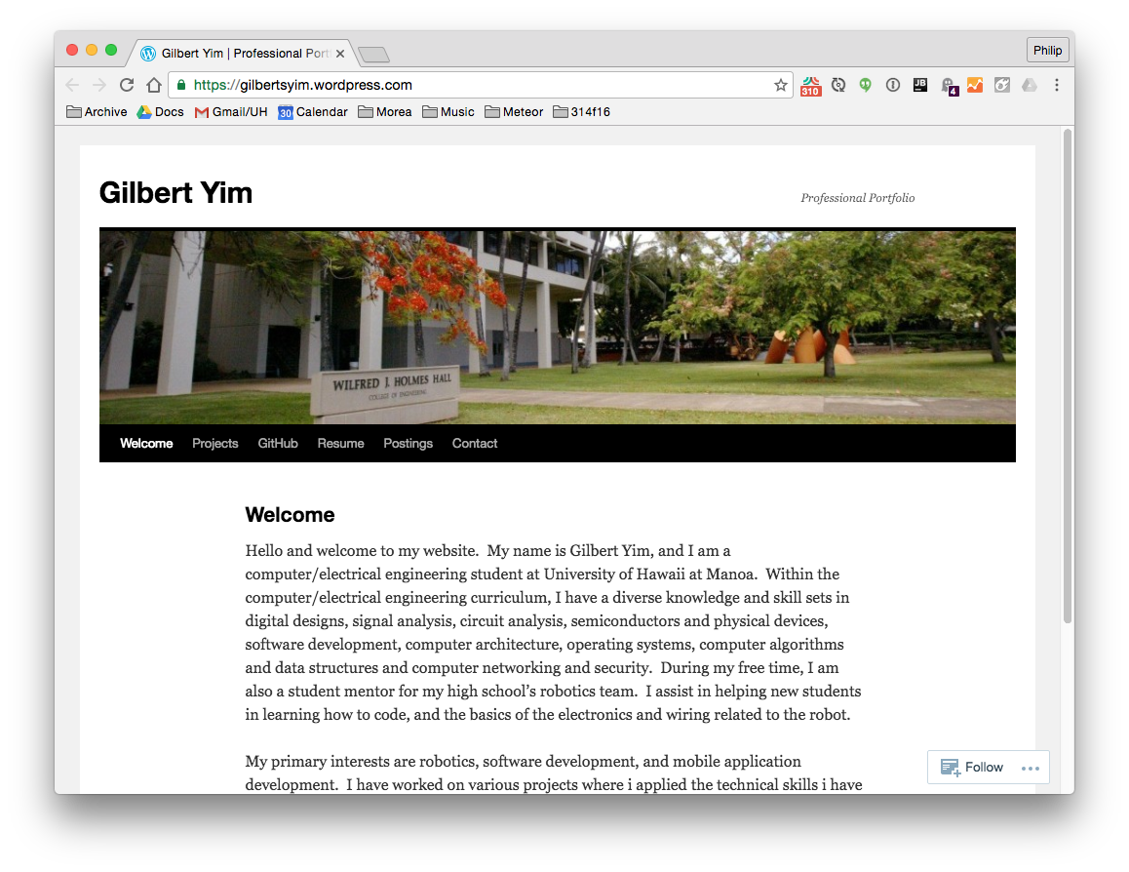

Slide 14
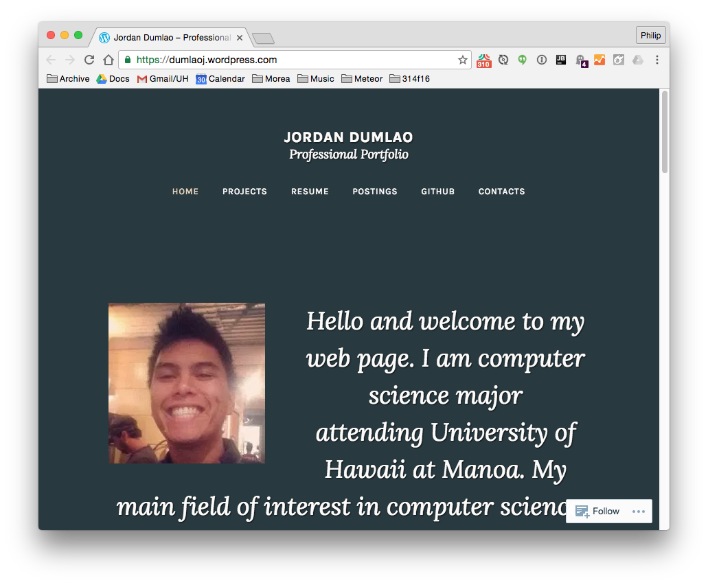

Slide 15
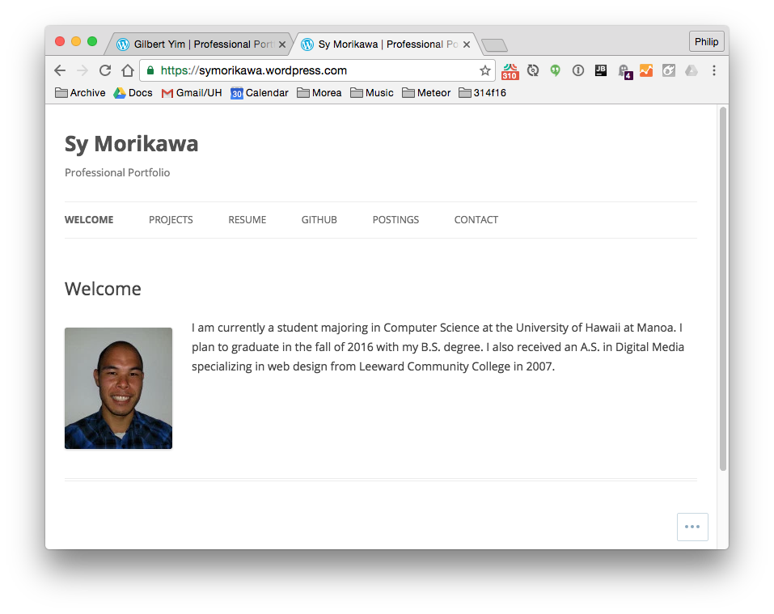

Slide 16
The problem with WordPress
Too easy to go off the rails.
“Portfolio” themes oriented toward photographers, not hackers.

Slide 17
Solution (Second try)

Slide 18
TechFolios

Slide 19




TechFolios =
+
+
+

Slide 20
How to use

Slide 21
1. Clone template 2. Edit details 3. Commit to username.github.io

Slide 22
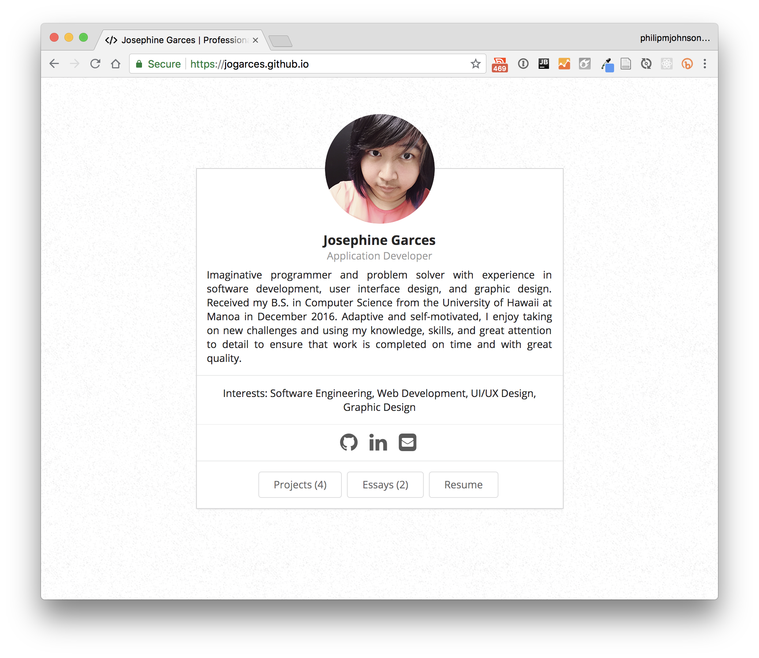

Slide 23
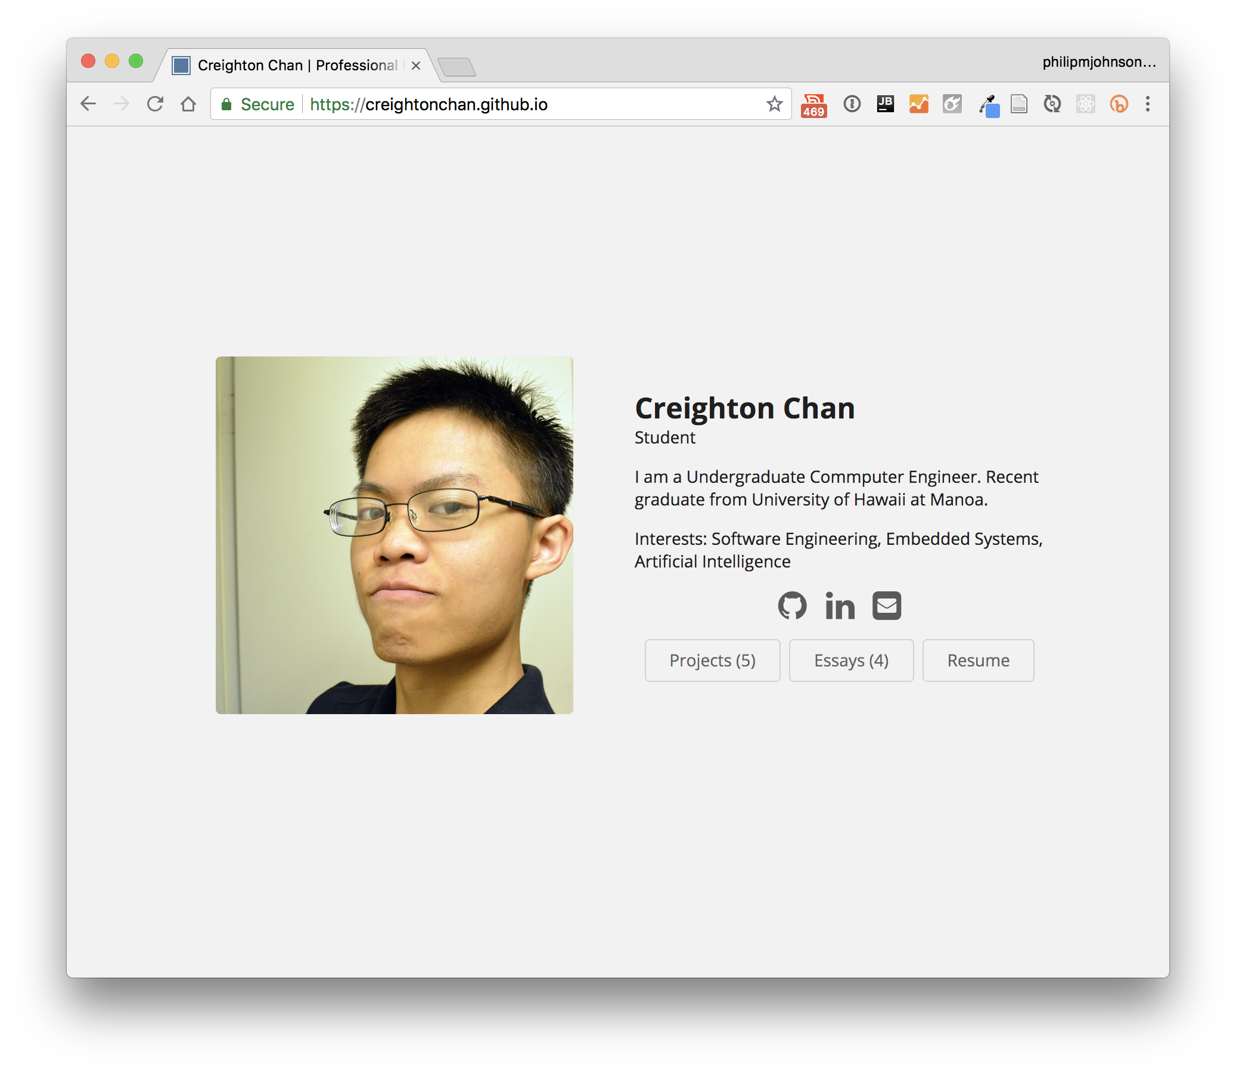

Slide 24
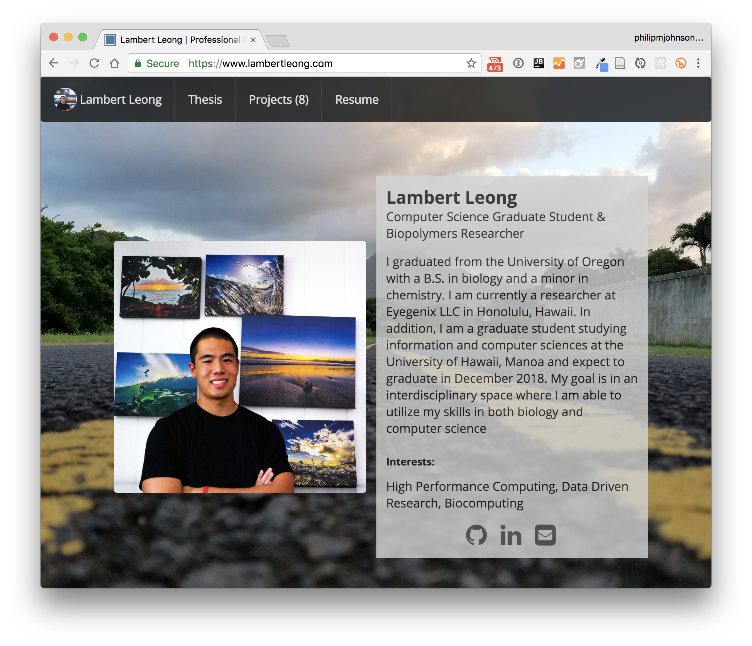

Slide 25
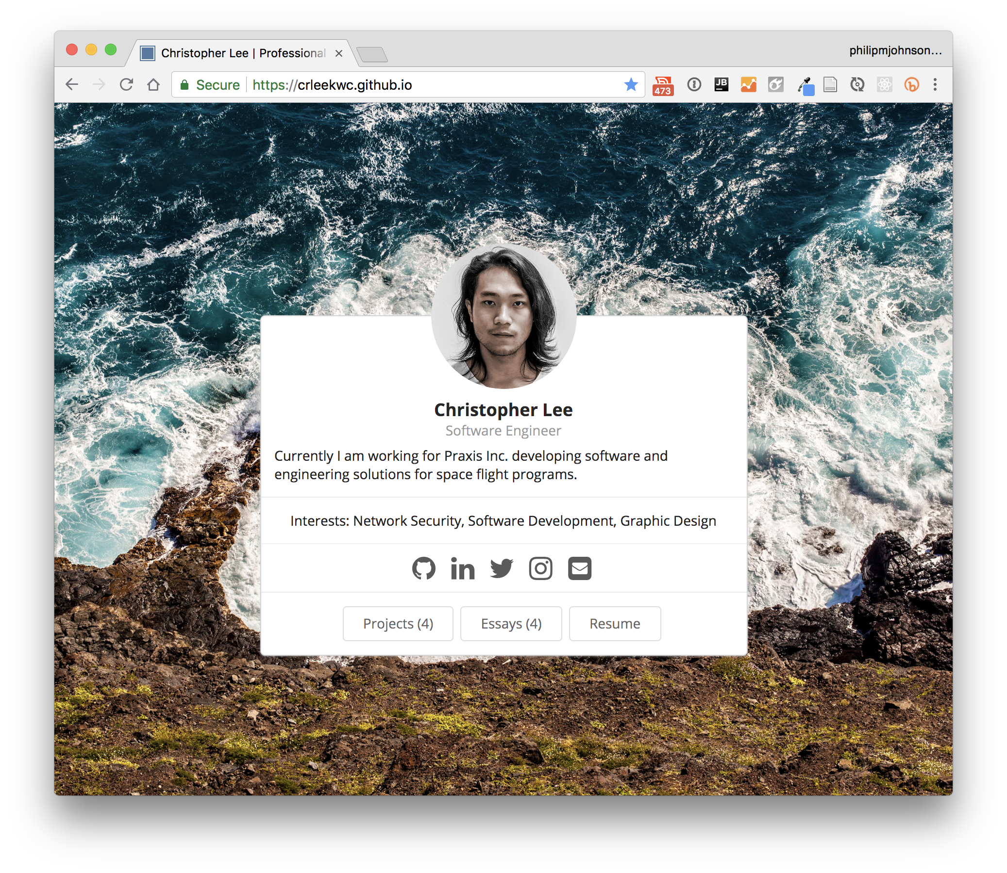

Slide 26
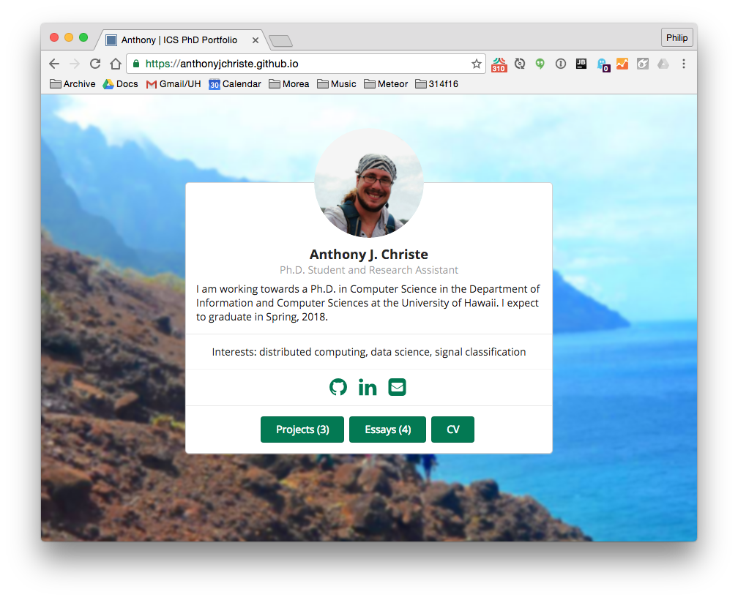

Slide 27
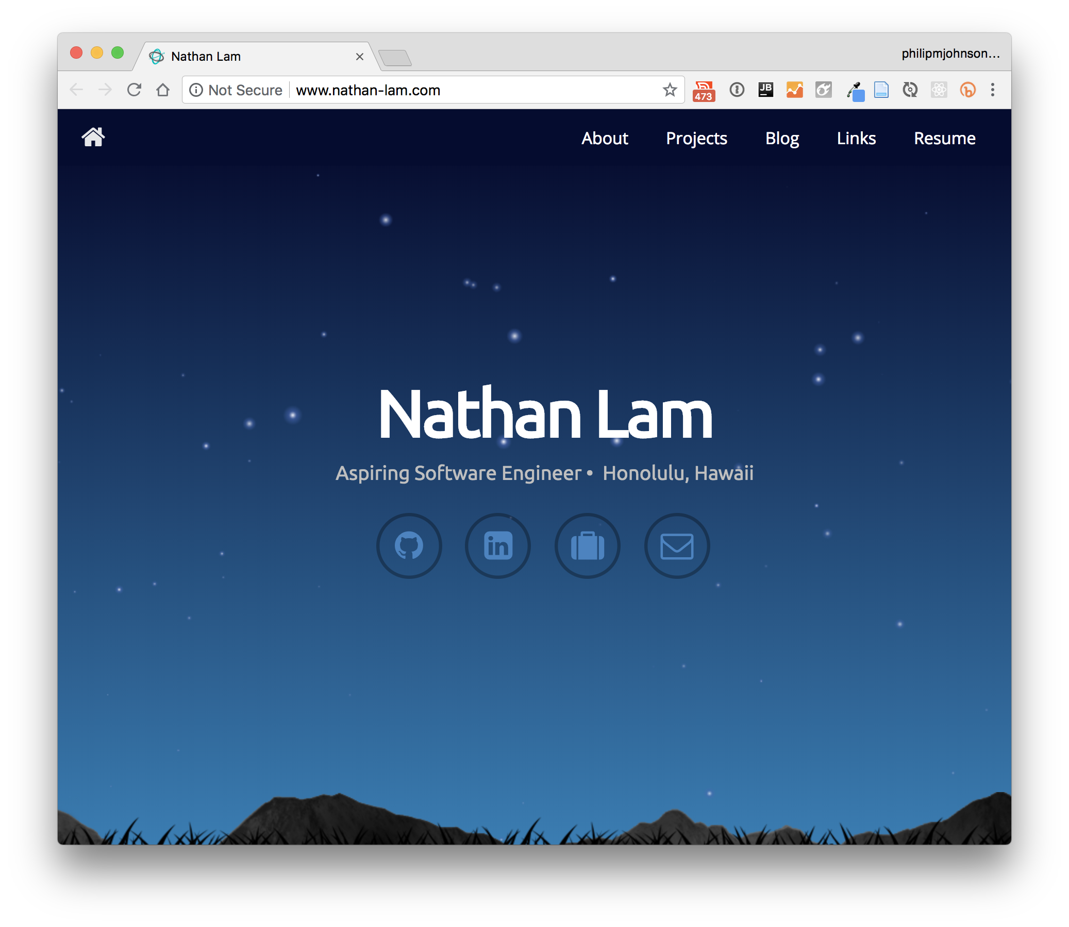

Slide 28
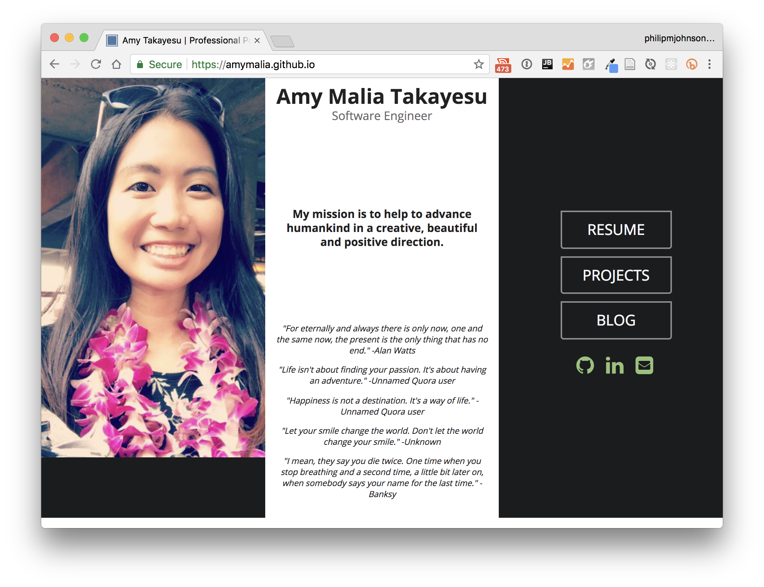

Slide 29
Structure of a TechFolio
Home Page:
Name, summary, interests, social network links
Projects:
Pages devoted to technical projects.
Essays:
Pages devoted to technical writing
Resume:
Online resume

Slide 30
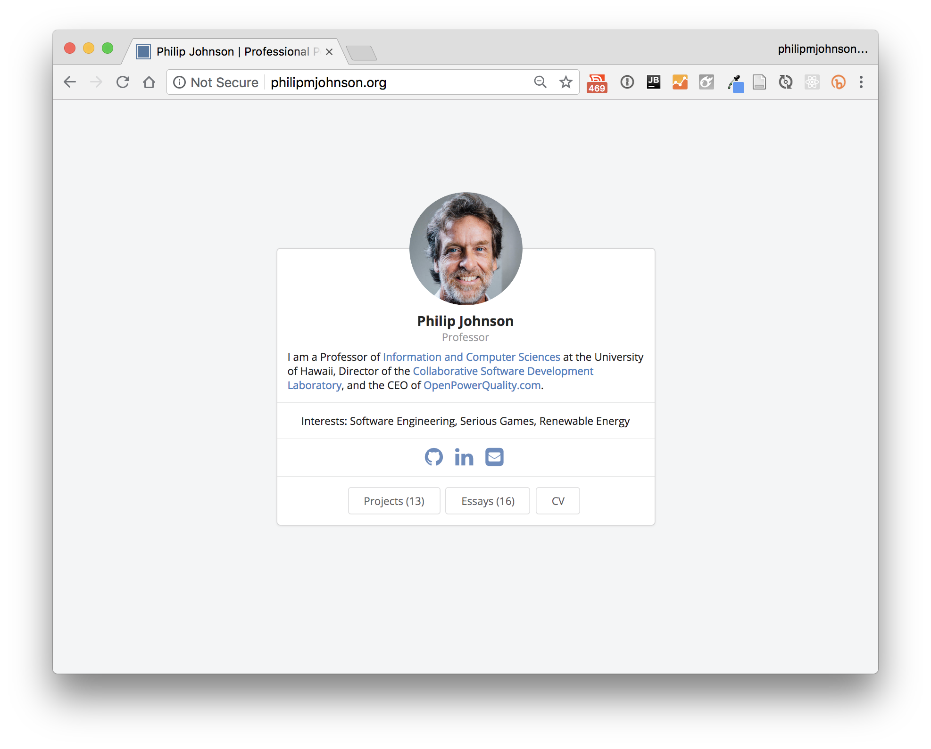

Slide 31
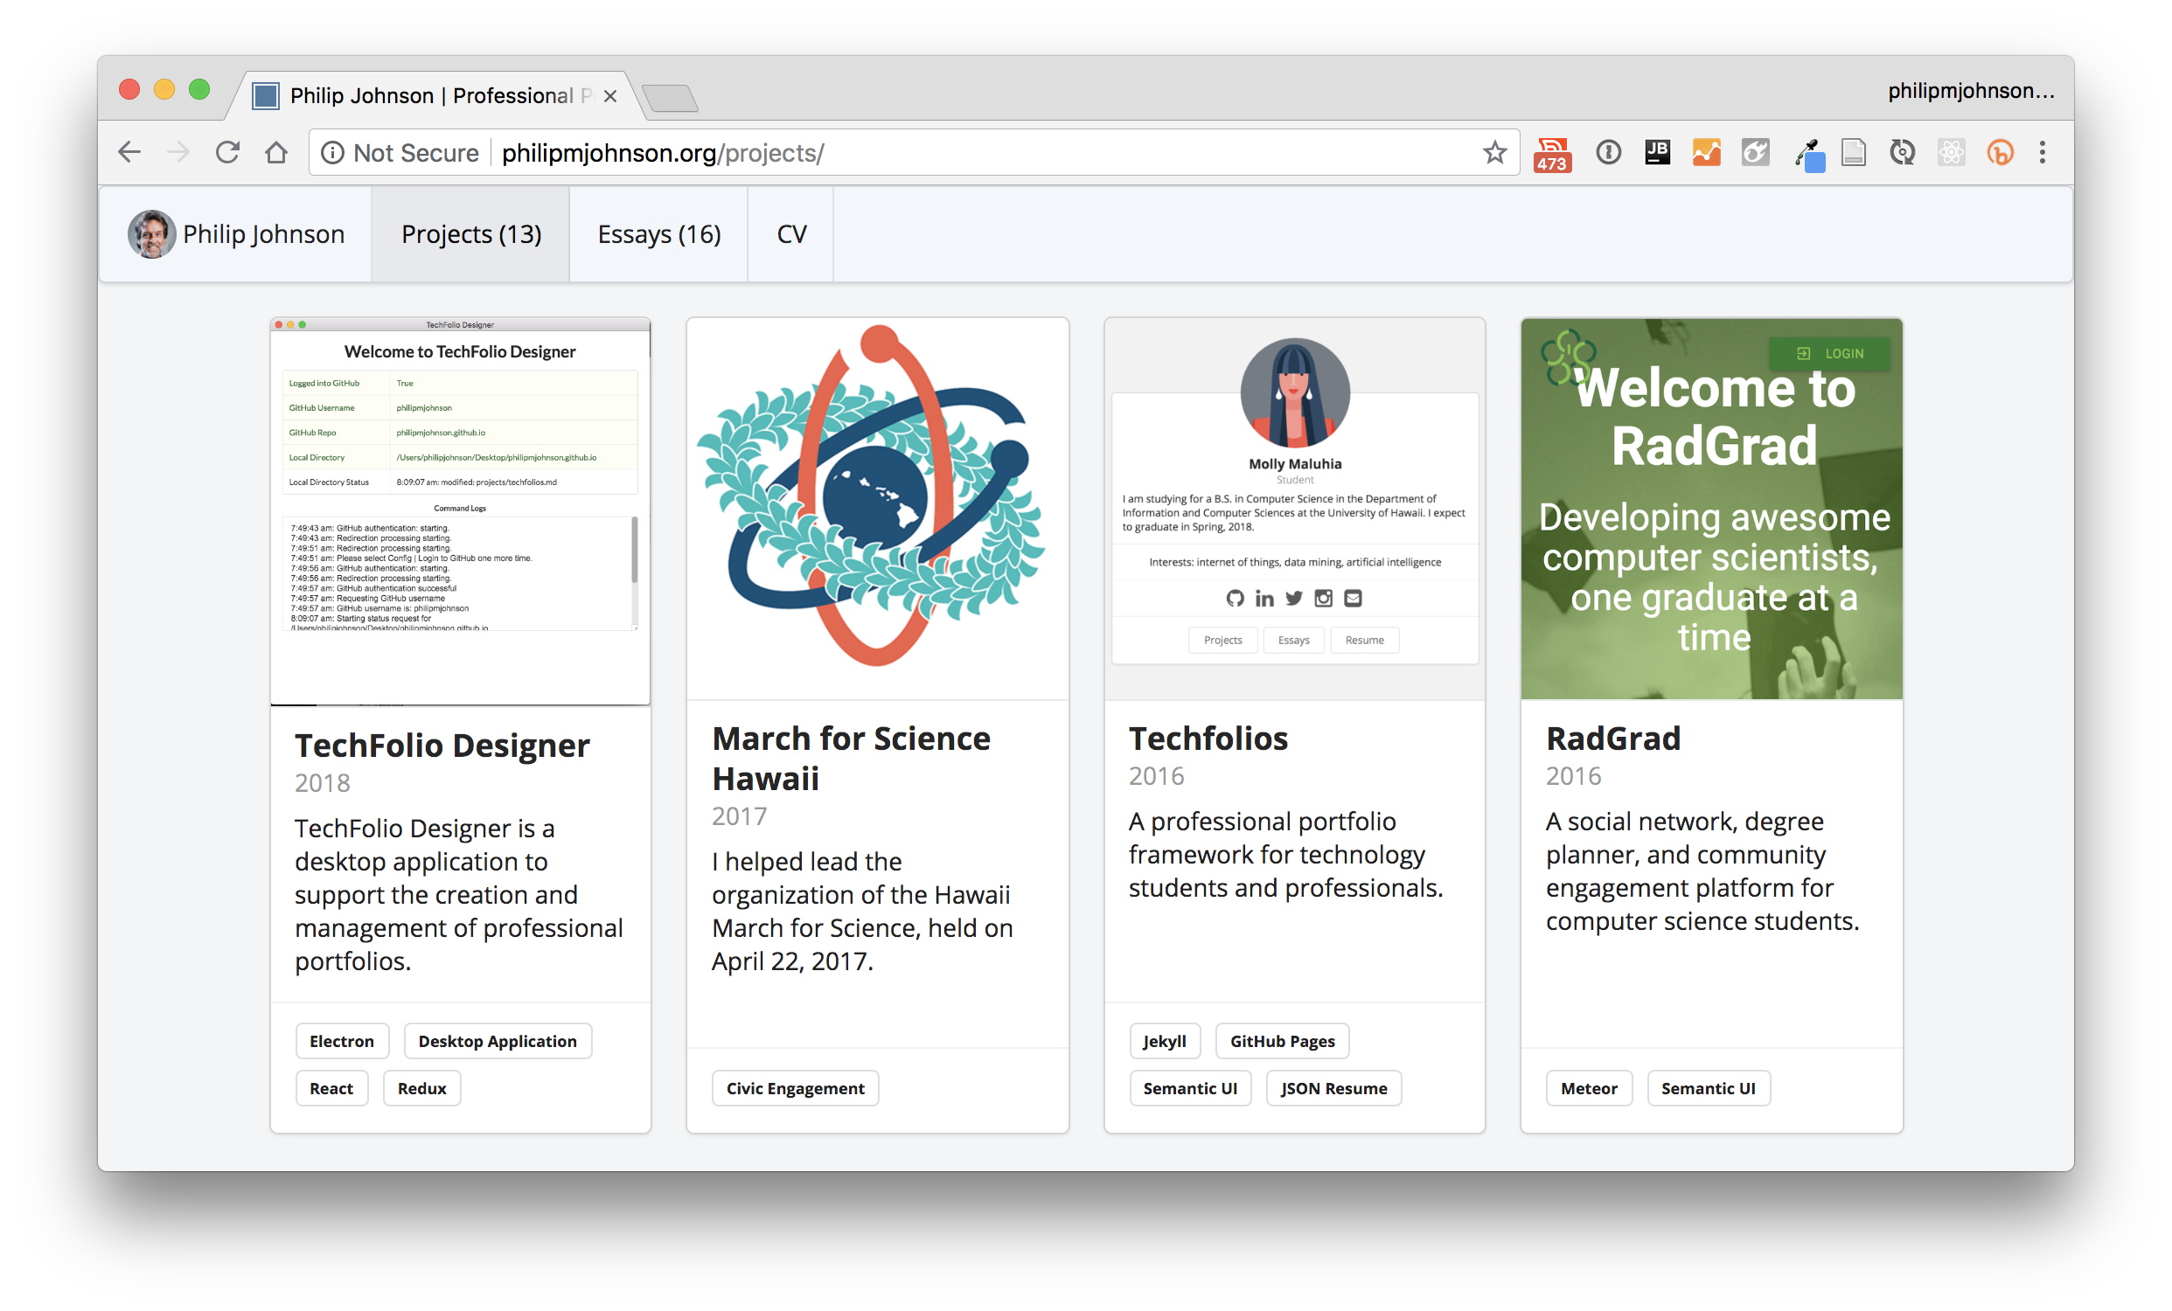

Slide 32
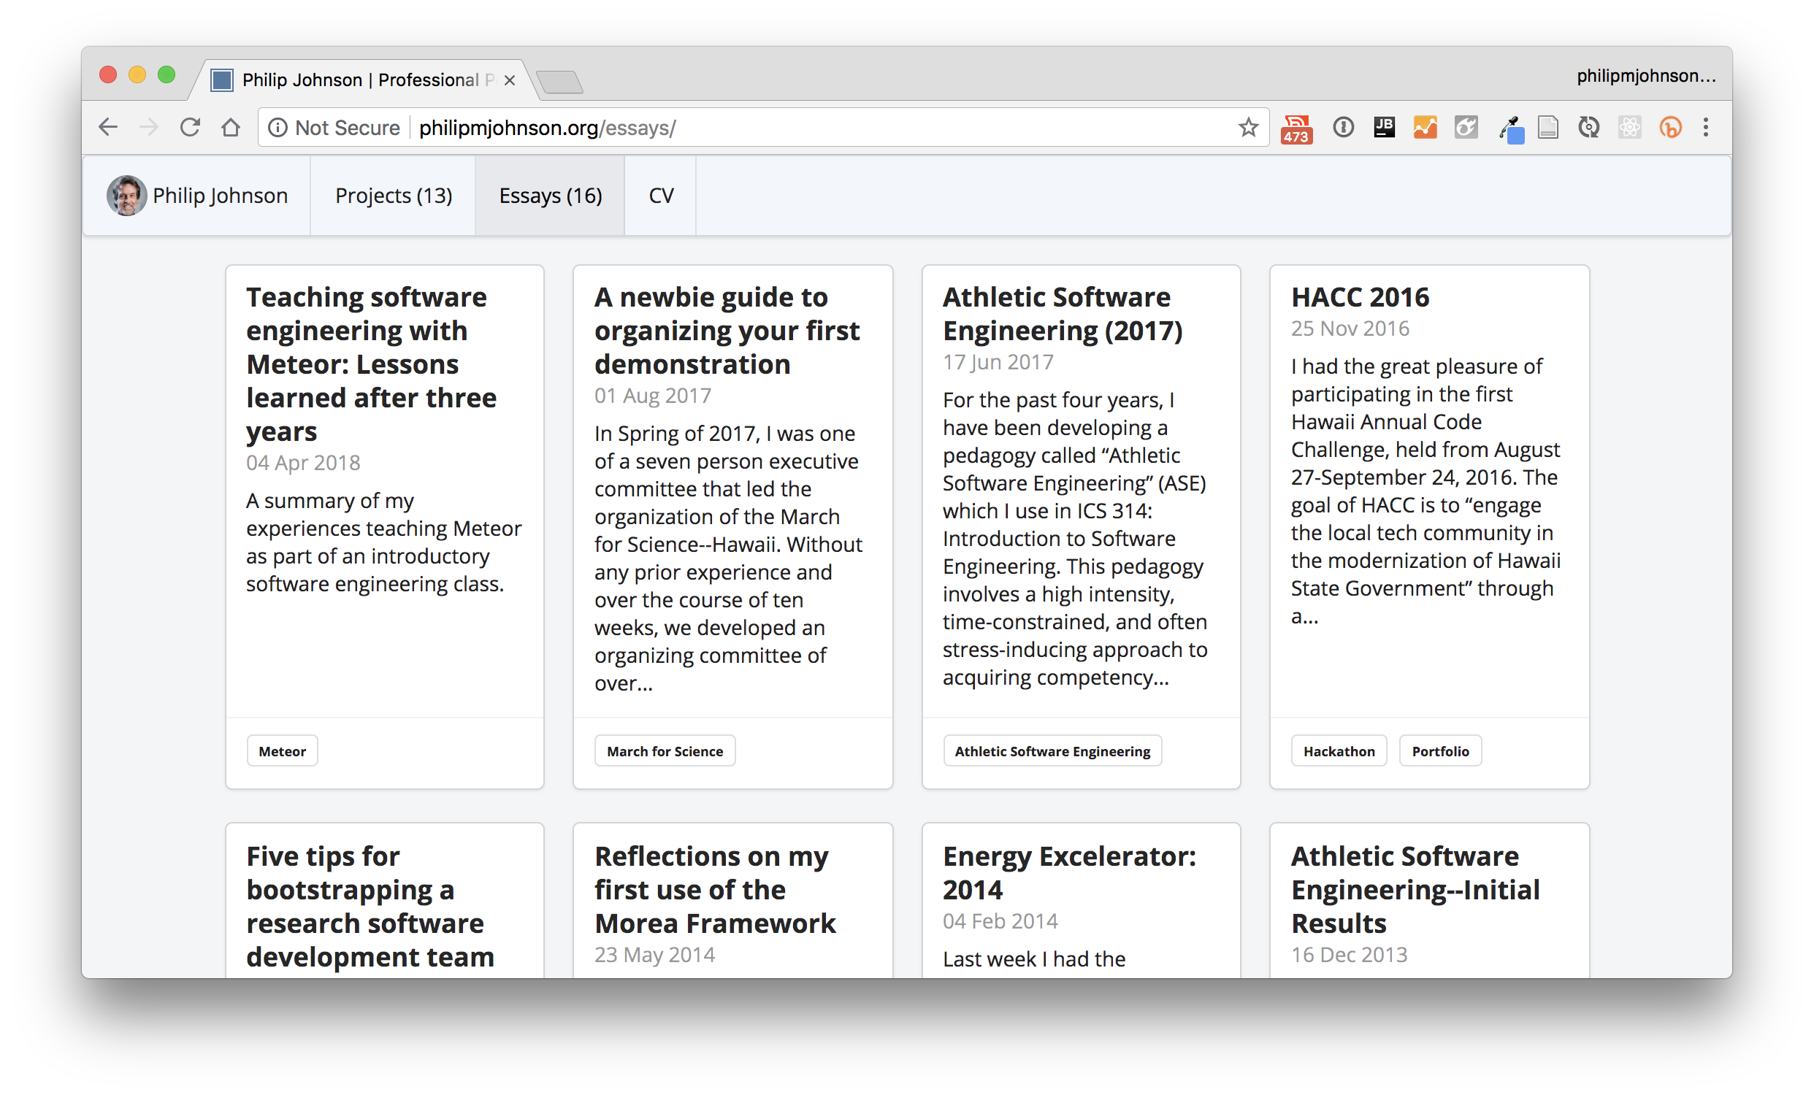

Slide 33
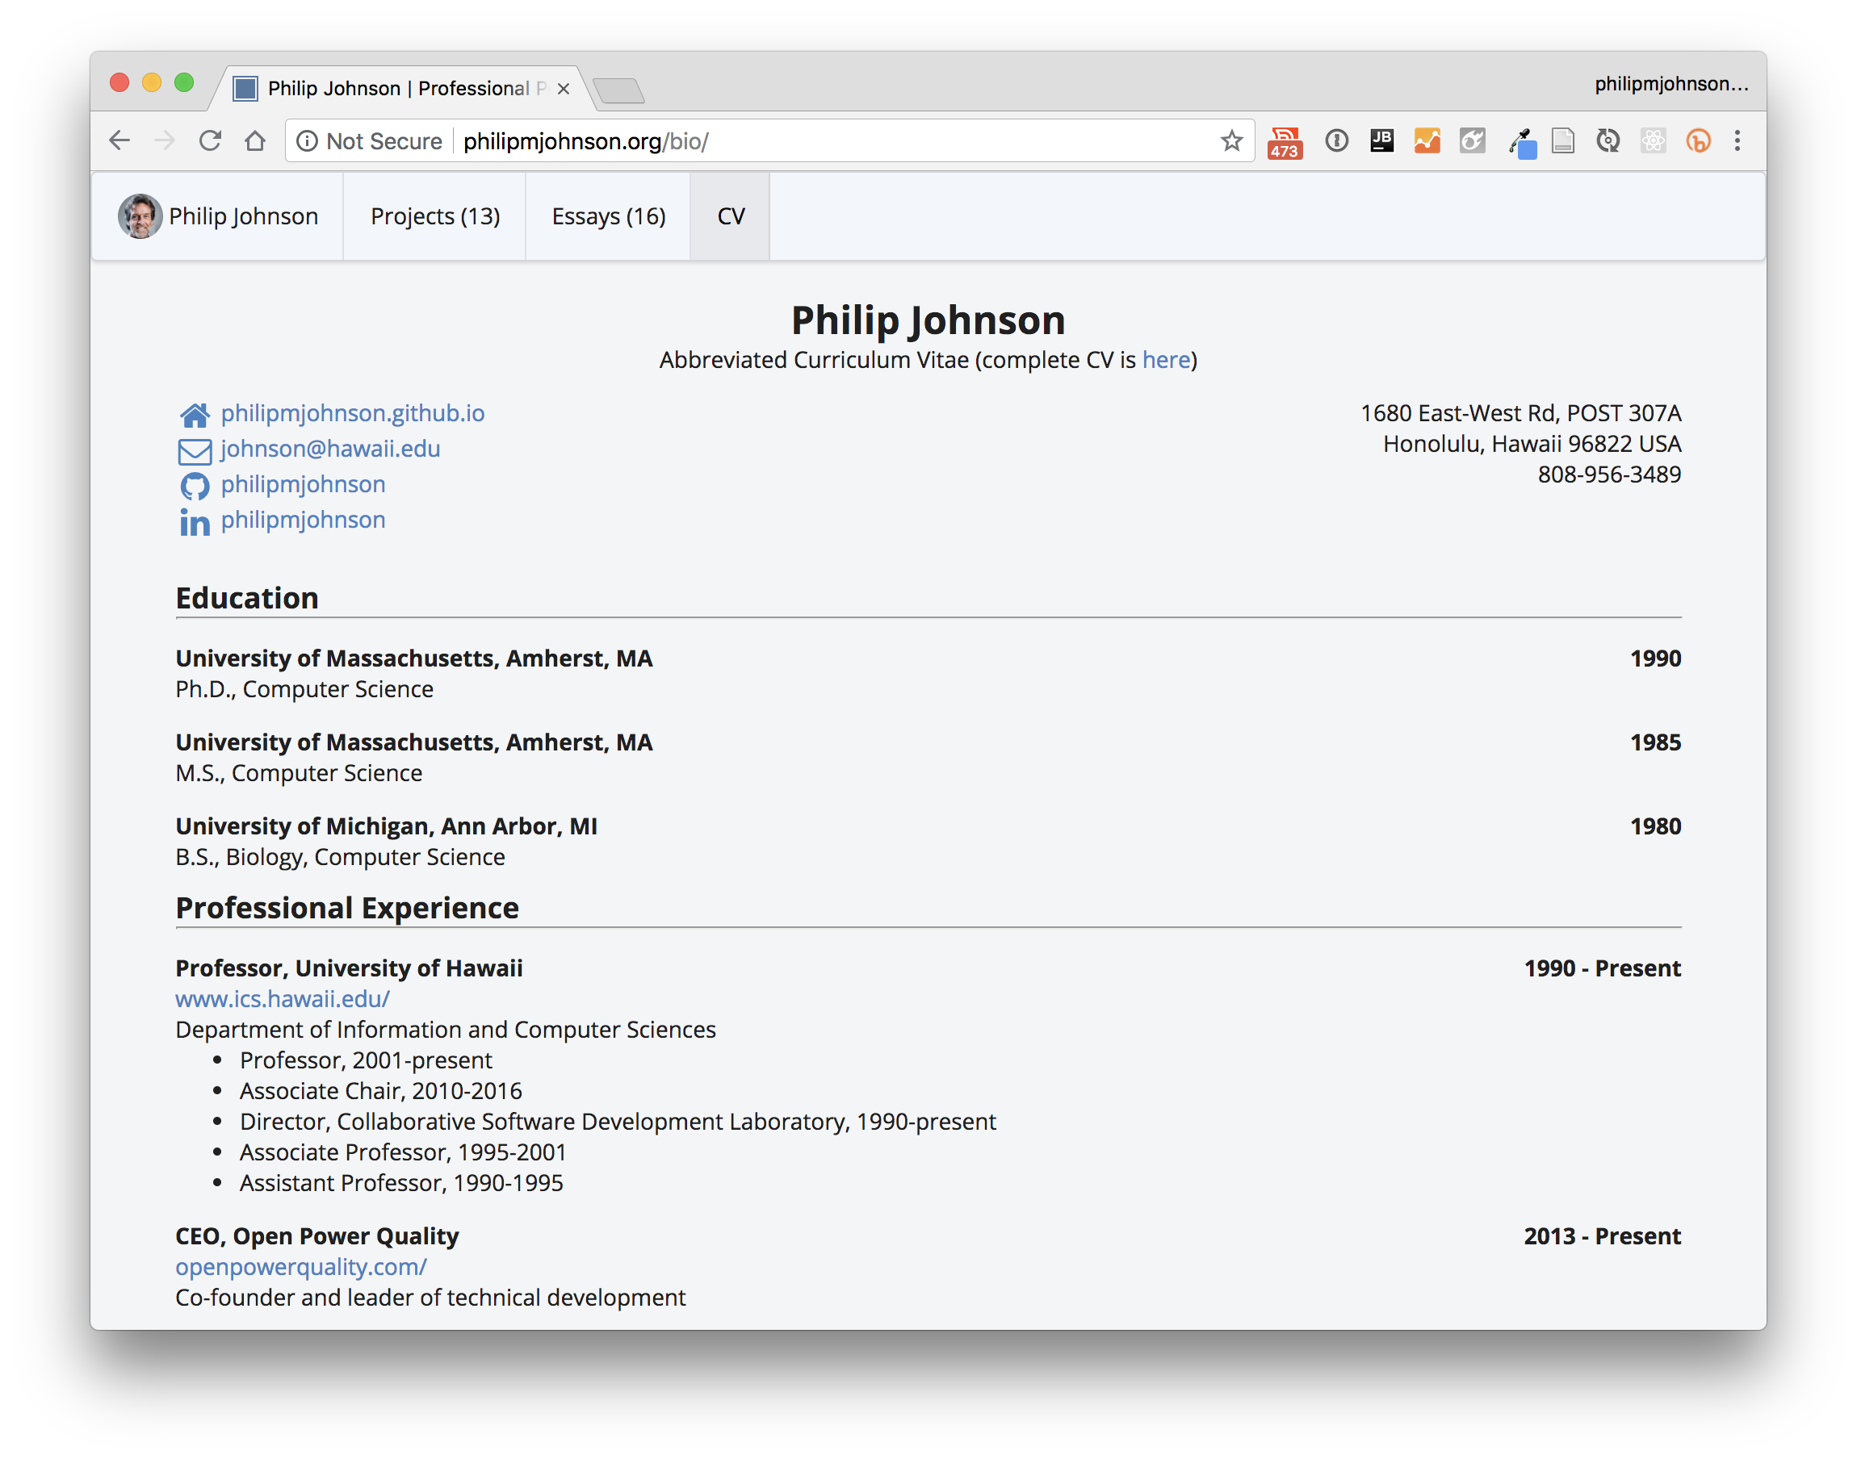

Slide 34
bio.json

Slide 35
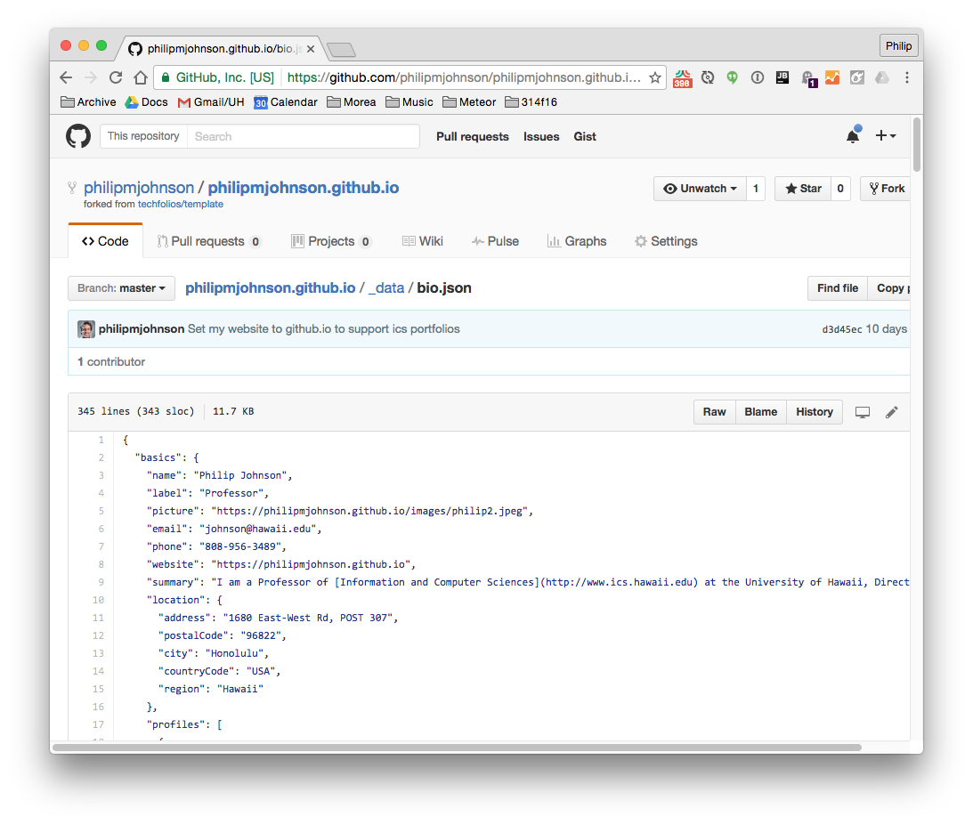

Slide 36
Hey! We could scrape the web!

Slide 37
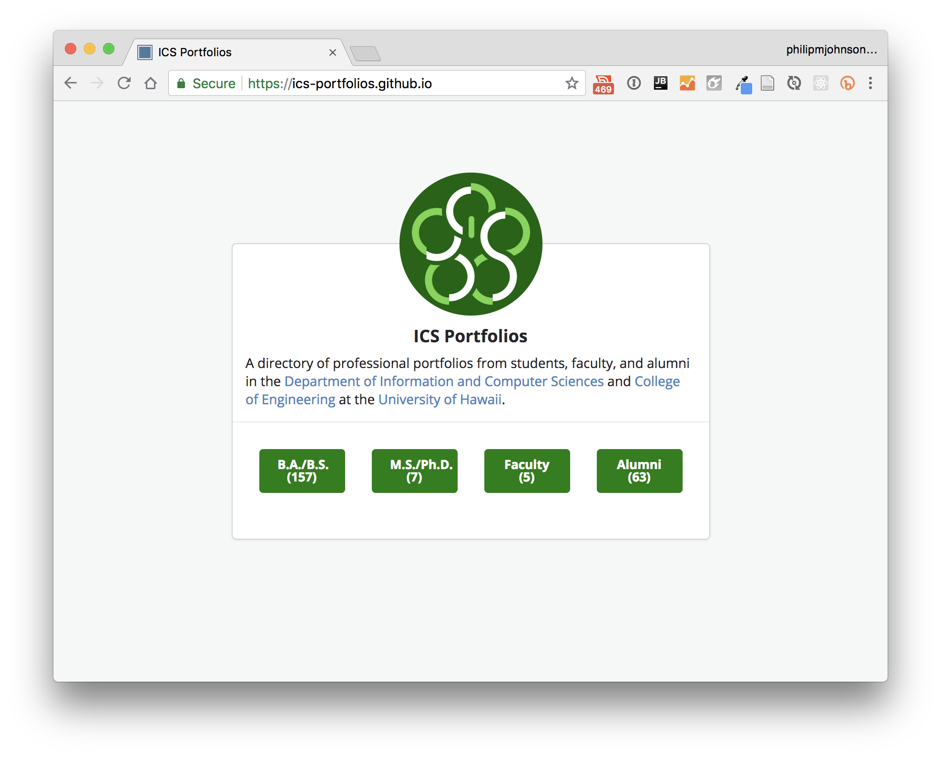

Slide 38
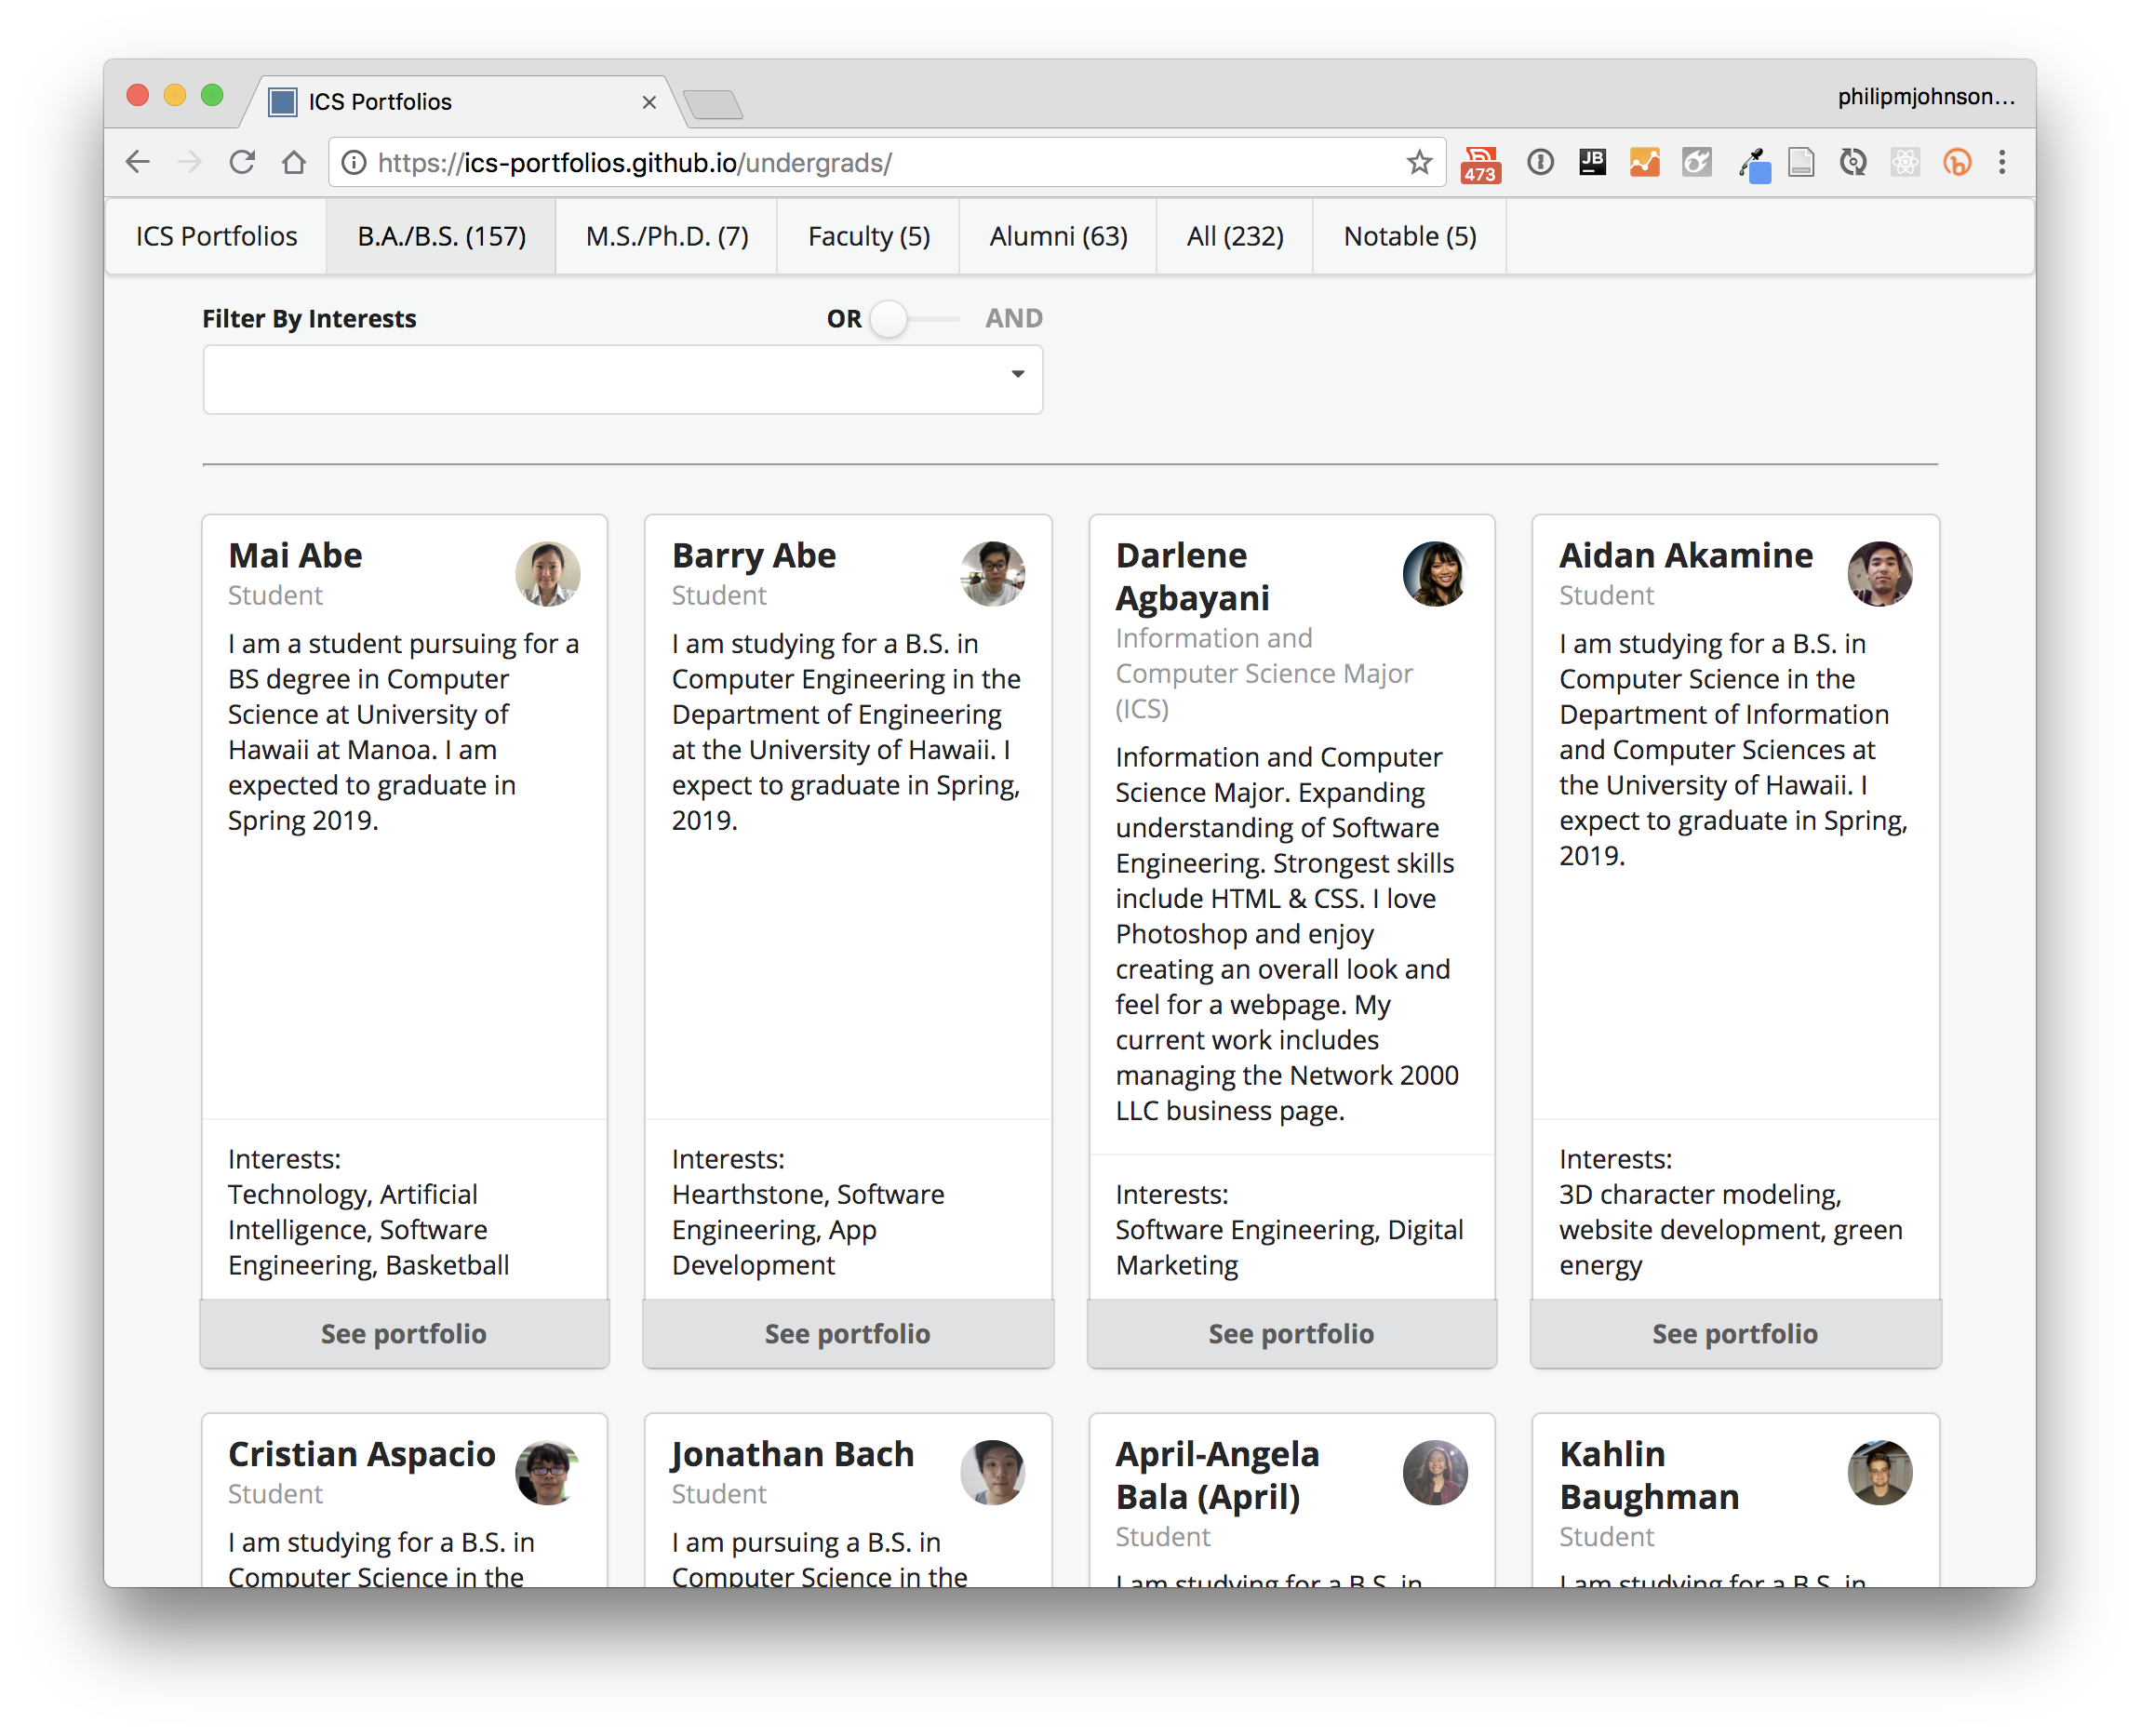

Slide 39
The goal of ics-portfolios
Help students with similar interests find each other.
Help students see what’s possible to accomplish during their ICS degree program.
Provide the local high tech community with insights into the ICS Department.

Slide 40
What’s in it for you?
Use techfolios to create your own professional portfolio.
Use ICS Portfolios to find students to hire.
Hack techfolios or ics-portfolios to increase its visual appeal and/or functionality.

